Slide 1
Design, Performance, and Calibration of CMS Hadron-Barrel Calorimeter Wedges
CMS NOTE 2006/138

Slide 2
This paper addresses the design, performance, and calibration of the HB.
This paper reports the first measurements of production modules with the complete electronics chain.
one of the goals of this study was to relate the radioactive source measurements to beam measurements in order to calibrate the HB wedges which were not exposed to particle beams. After these measurements were performed, the HB wedges were assembled into the final barrel configuration.

Slide 3
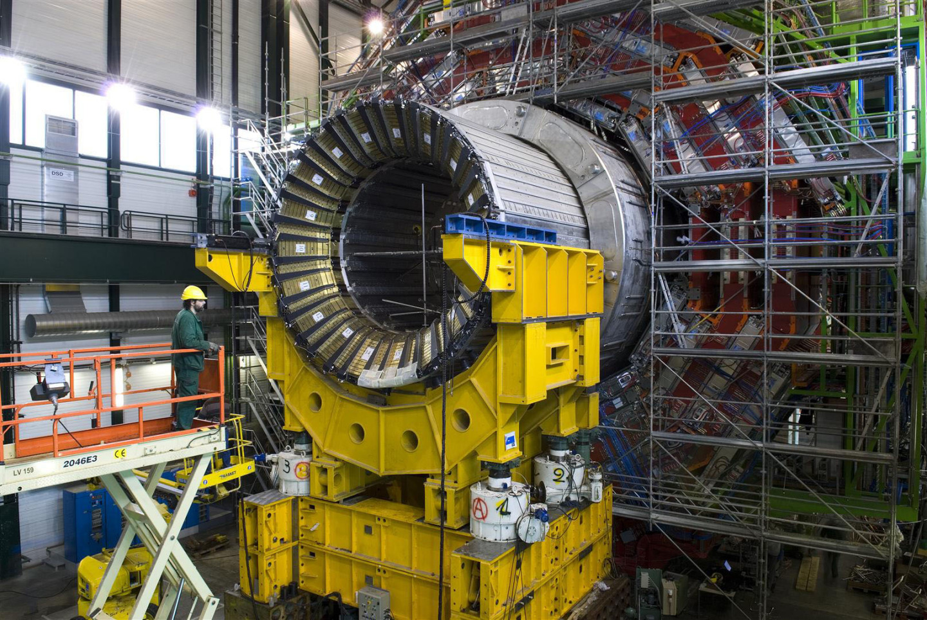
Fig: CMS Hadron-Barrel Calorimeter
Source:http://cds.cern.ch/record/1431485/files/0603041_02-A4-at-140005.jpg?subformat=icon-1440

Slide 4
Outline
Section 1: Introduction
Section 2: The design details of the hadronic calorimeter
Section 3 & 4: Topics related to electronics and data acquisition and the test beam setup.
Section 5: HB performance in particle beams
Section 6: Performance of the prototype electromagnetic module (EB).
Section 7: Results of the data analyses of the combined calorimeters
Section 8: Comparison of the combined results with Monte Carlo predictions
Section 9: Summary of the radioactive source calibration

Slide 5
Introduction

Slide 6
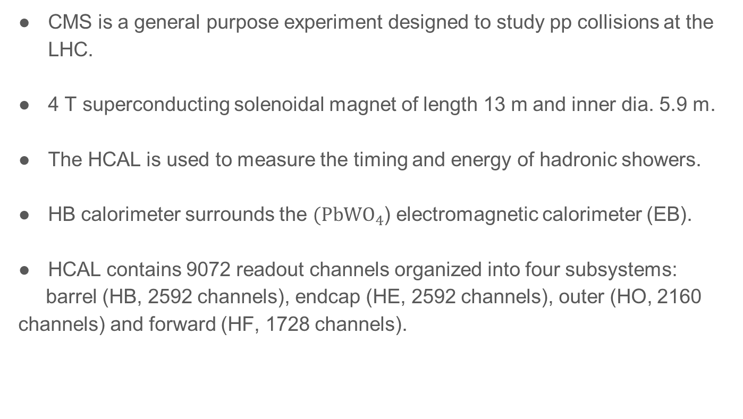
CMS is a general purpose experiment designed to study pp collisions at the LHC.
4 T superconducting solenoidal magnet of length 13 m and inner dia. 5.9 m.
The HCAL is used to measure the timing and energy of hadronic showers.
HB calorimeter surrounds the $(PbWO_{4}$) electromagnetic calorimeter (EB).
HCAL contains 9072 readout channels organized into four subsystems:
barrel (HB, 2592 channels), endcap (HE, 2592 channels), outer (HO, 2160 channels) and forward (HF, 1728 channels).

Slide 7
2. HCAL Barrel Design

Slide 8
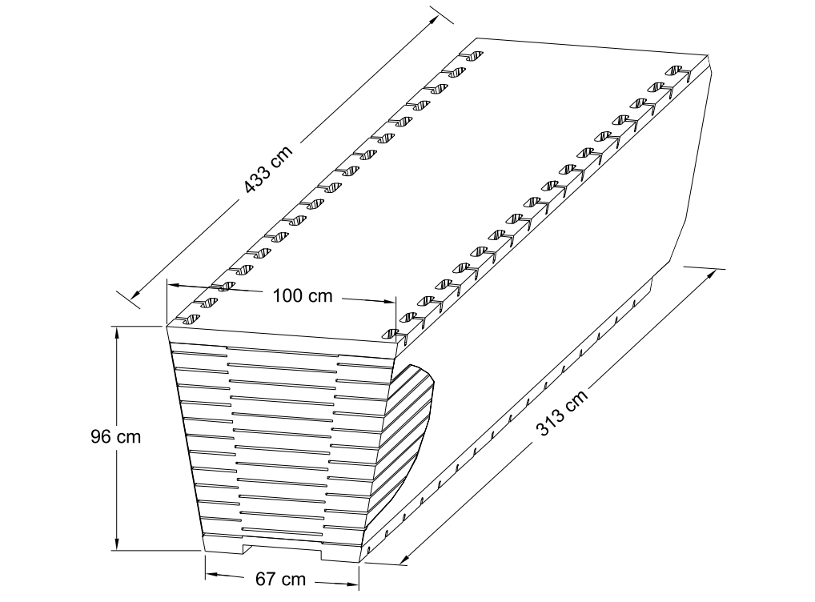
Figure 2: Isometric view of an HB wedge.
Source: CMS NOTE 2006/138

Slide 9
HB Covers the pseudorapidity range −1.3 < η < 1.3.
36 identical azimuthal wedges (∆φ = 20◦), which form two half-barrels (HB+ and HB–).
Each wedge is further segmented into four azimuthal (∆φ = 5◦) sectors.
Plates are bolted together in a staggered geometry.
The scintillator is divided into 16 η sectors, resulting in a segmentation of (∆η, ∆φ) = (0.087, 0.087).

Slide 10
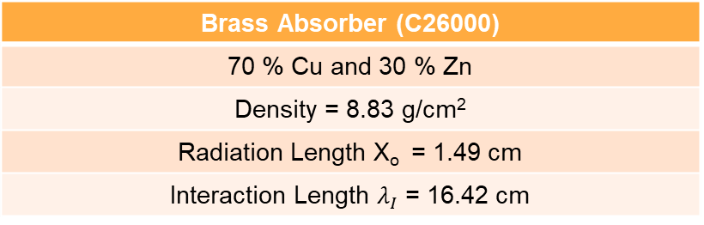

Absorber Geometry
The HB effective thickness increases with polar angle; 10.6 λI at |η| = 1.3. EB adds $∼1.1λI$.
Back Steel Plate (75 mm)
6 Brass plates (56.5 mm)
8 Brass plates (50.5 mm)
Front Steel Plate (40 mm)
Beam Direction
Brass Absorber (C26000)
70 % Cu and 30 % Zn
Density = 8.83 g/cm²
Radiation Length X_{o} = 1.49 cm
Interaction Length $λ_{I}$ = 16.42 cm

Slide 11
2.2 Scintillator
CMS HCAL active elements consist of about 70,000 scintillator tiles.
Tray:
Single azimuthal Section and a depth layer are grouped into a single scintillator unit referred to as a tray.
Made of individual optically independent scintillators with white painted edges wrapped in Tyvek 1073D sheets.
HB Scintillator
A 3.7-mm thick Kuraray SCSN81 plate was used
Long term stability and acceptable radiation hardness
First layer (Layer-0) is made of 9-mm thick Bicron BC408.
Last layer (Layer-16) is 9-mm thick Kuraray SCSN81.
Used to oversample early and late developing showers

Slide 12
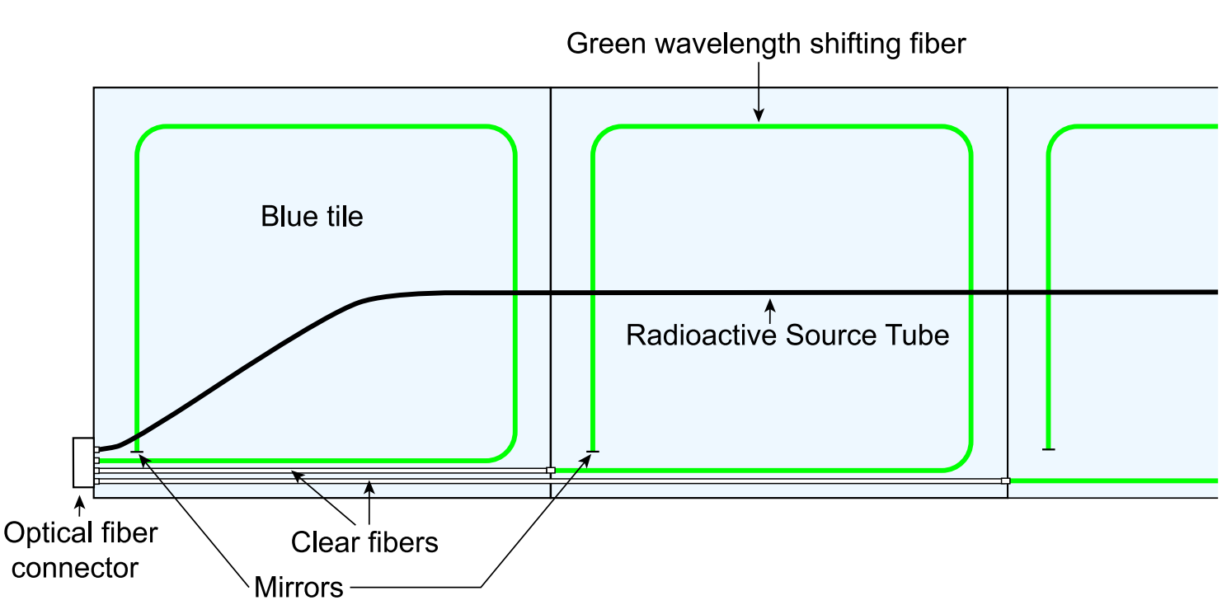
Fig: Schematic of a partial scintillator tray
Source: CMS NOTE 2006/138
Wavelength shifting fiber (Kuraray Y11)
Green double clad, 0.94 – mm diameter
Mirrorred at the tip; average reflectivity ∼ 83% with a spread of about 6.5%
Spliced to clear fibers; transmission efficiency: 92.6%, rms :1.8%

Slide 13
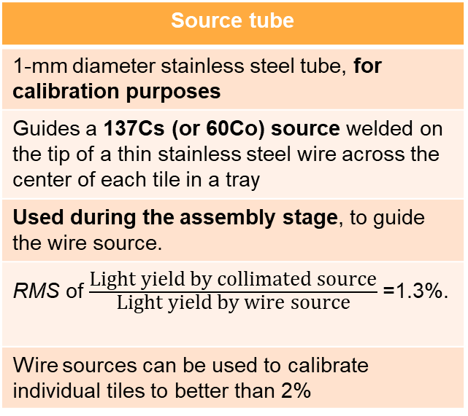
Scintillator plates
WLS
Clear Fibers
Optical connector
Optical unit
Hybrid photodiode
(HPD)
Source tube
1-mm diameter stainless steel tube, for calibration purposes
Guides a 137Cs (or 60Co) source welded on the tip of a thin stainless steel wire across the center of each tile in a tray
Used during the assembly stage, to guide the wire source.
RMS of $\frac{\text{Light} \text{yield} \text{by} \text{collimated} \text{source}}{\text{Light} \text{yield} \text{by} \text{wire} \text{source}}$=1.3%.
Wire sources can be used to calibrate individual tiles to better than 2%
Arranges the fibers into readout towers
Testing of the tray
Collimated ¹³⁷Cs source, illuminated a 4-cm diameter spot on the tray
Determined the relative yield of each tile and uniformity of each tray.
RMS of response and transverse uniformity of each tile = 4.6%, spread of 4.5%
Results imply - tile uniformity contributes negligibly to the fractional energy resolution of the HCAL.

Slide 14
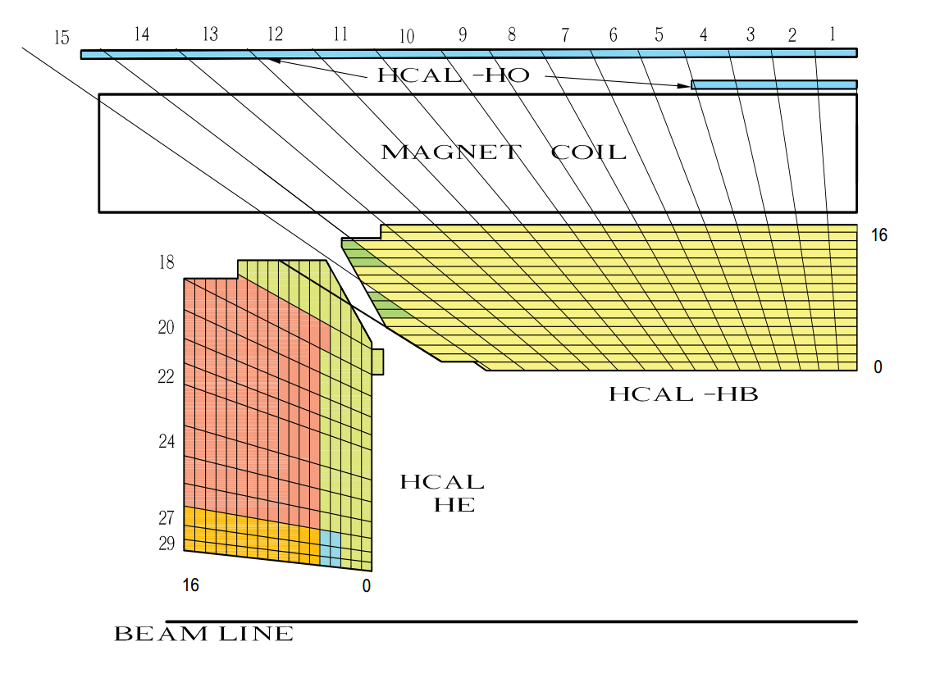
2.3 Longitudinal Segmentation
Tower number
Scintillator layer number
Figure 4: The HCAL tower segmentation for one-fourth of the HB, HO, and HE detectors.The shading
represents independent longitudinal readouts in the HB/HE overlap and the small angle regions.

Slide 15
Towers 1 through 14, all have a single longitudinal readout
Towers 15 and 16 are segmented in depth.
Front segment of Tower 15 contains either 12 or 13 scintillator layers.
Rear segment of Tower 15 has three scintillator layers.
Tower 16 has five layers in the front segment and three in the rear.
Tower 16 does not have a Layer-0 scintillator.

Slide 16
3. Electronics and Data Acquisition

Slide 17
Each wedge contains 72 channels of front-end electronics mounted on the detector periphery near Tower 14 in an enclosure referred to as a readout box (RBX).
A single RM contains an 19-channel HPD which registers signals from an independent (∆η, ∆φ) = (0.0875, 0.0875) tower.
RBX
Each RBX is divided into
Readout
four readout modules
Modules

Slide 18
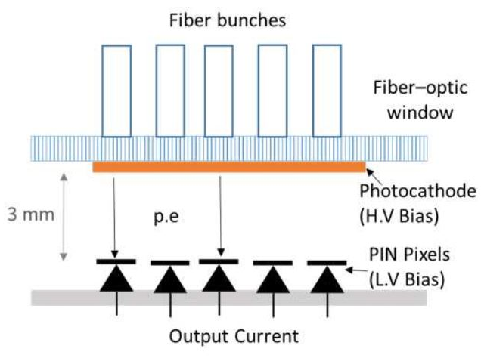
Photoelectrons are accelerated to ∼ 8 kV kinetic energy and strike the diode causing ionization.
Collection of the liberated holes leads to a gain of about 1600.
The diode consists of 19 electrically
independent readouts.
The HPD signals are fed into three 6-channel
readout cards located inside the RM which
performs charge integration and encoding (QIE).
The QIE is a non-linear multi-range ADC designed to provide approximately constant relative precision over a wide dynamic range.

Slide 19
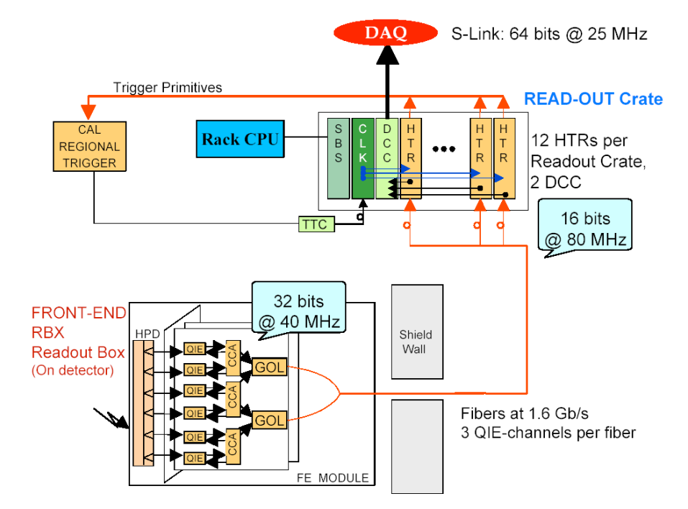
Figure 5: Overview of the HCAL data acquisition electronics. Source: CMS NOTE 2006/138

Slide 20
3.1 Trigger and Readout Modules
Data from Detector to HCAL trigger and readout modules (HTR) via gigabit optical links (GOL).
The HTR is equipped with
optical receivers,
timing and trigger (TTC) signal circuitry,
serial low voltage digital signal outputs (LVDS-Channel Link) to the data concentrator card (DCC), and FPGA for trigger outputs.

Slide 21
The HTR includes two data pipe-lines:
The trigger pipe-line assigns the front-end data to a particular LHC bunch crossing and sends them to the CMS trigger.
The data acquisition pipe-line stacks the frontend data and sends it to the DCC which performs the data acquisition task.

Slide 22
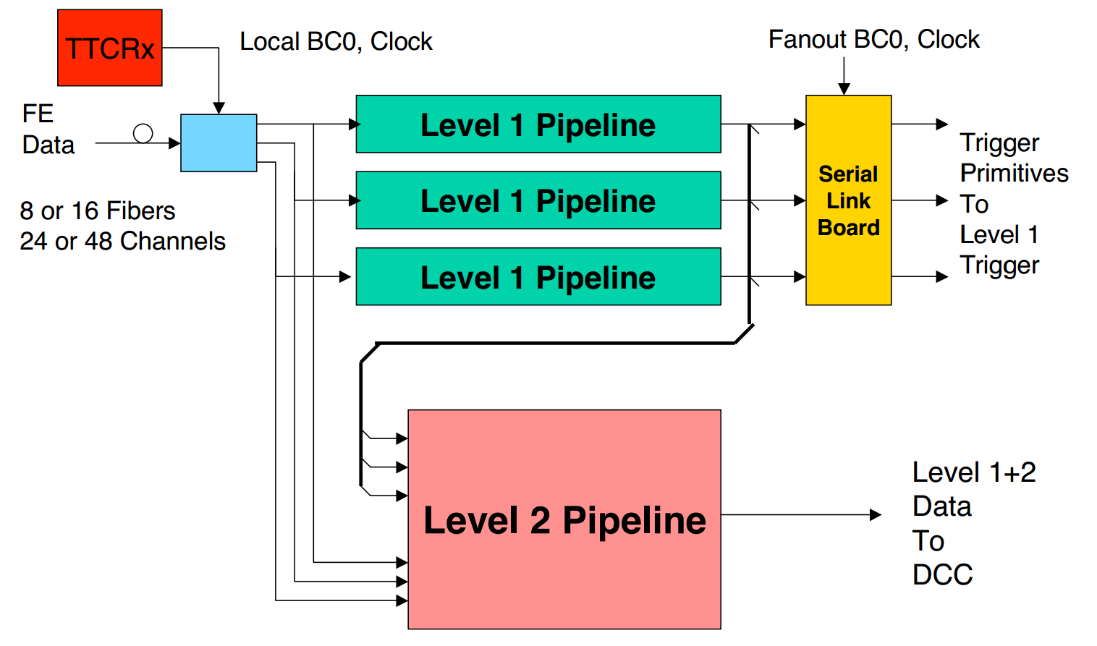
Figure 6: Block diagram of the HTR electronics. The data from the detector drives two pipelines; one
to the CMS trigger and a second to the CMS data acquisition via DCC.
Source: CMS NOTE 2006/138

Slide 23
3.2 Data Connector Card
The LVDS link receiver boards contain three independent link receivers which can operate at 20–66 MHz (16-bit words). Event building, protocol checking, event number checking and bit error correction are performed independently for each link.
The DCC logic is designed to operate continuously at the full speed of the two input PCI busses, namely (33 MHz)×(32 bits)×(2).
The event builder and output logic must thus run at an average rate of at least
66 MHz (32-bit words) or 264 MBytes/sec.
The event builder output is sent in parallel to several destinations.

Slide 24
The outputs of event builder are:
The data acquisition (DAQ) output: Every event is sent to the CMS DAQ.
The trigger data output: The trigger information sent to the CMS Level-1 trigger is also sent to a special trigger DAQ system for monitoring of the trigger performance.
The spy output: A selected subset of events is sent to a VME-accessible memory for monitoring and diagnostics.

Slide 25
3.2 Data Acquisition Card
Hamming error correction is used for the LVDS links between the HTR and DCC.
All single-bit errors are corrected and all double-bit errors are detected by this technique.
Event synchronization is checked by means of an event number in the header and trailer of each event, which are checked against the TTC

Slide 26
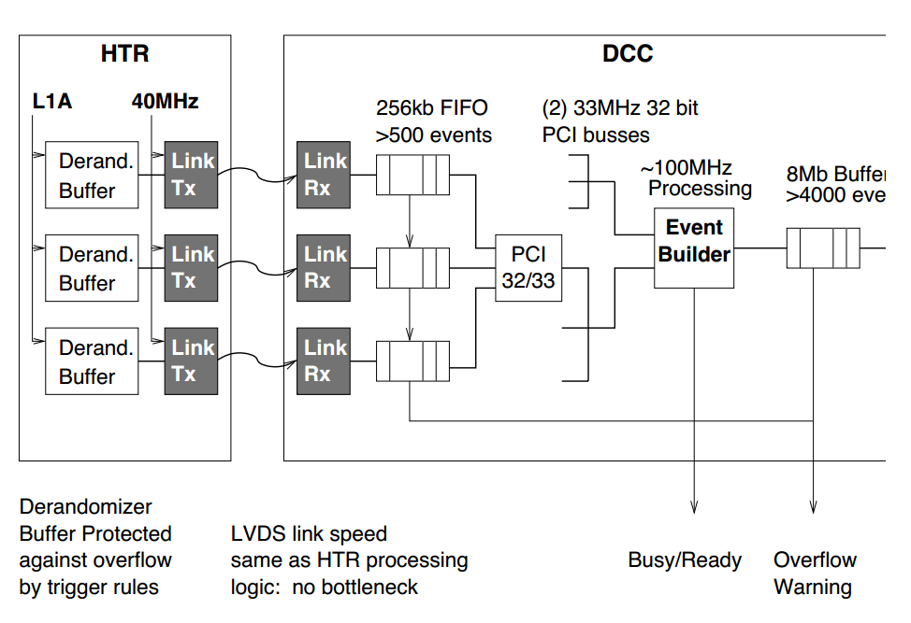
Figure 7: HCAL DAQ buffering schematic. The HTR sends the received data to the DCC. The DCC
stores event fragments in FIFO buffers on the input and output. Source: CMS NOTE 2006/138

Slide 27
4. Test Beam Setup

Slide 28
4. Test Beam Setup
The data were recorded during 2002 at the CERN H2 test beam. A moving platform held two production HB wedges plus a prototype electromagnetic crystal calorimeter which was inserted in front of the HB for some of the measurements.
The two-dimensional movement of the platform in φ and η directions allowed the beam to be directed onto any tower of the calorimeter.
Four scintillation counters were located approximately three meters upstream of the calorimeters and a coincidence between a subset of these counters was used for the trigger.

Slide 29
4.1 ECAL Module
The electromagnetic calorimeter module used for the combined measurements consisted of 49 lead tungstate crystals arranged in a 7 × 7 array.
The crystals were consistent with the CMS electromagnetic calorimeter design. The construction of this prototype roughly approximates the final configuration of the CMS EB in terms of spatial location of the crystals and approximate material between the EB and the HB
Each crystal however was coupled to a single photo-multiplier tube through a plastic light guide located at the front of the crystal.
The PMT signals were digitized by CAEN V792 charge-to-digital converters (QDC).

Slide 30
4.2 Data Sets
Data were taken with electron beam momenta of 20, 30, 50 and 100 GeV/c, pion beam momenta of 20, 30, 50, 100, and 300 GeV/c, and a muon beam of momentum 225 GeV/c. The momentum spread of the pion beam was established by collimators which were typically set better than ∆p/p = ±1% and contributes negligibly to the calorimeter resolution.
Beams were directed into the centers of all towers but was limited to the bottom two 5◦ sectors of the top wedge for mechanical reasons.
For both wedges, the scan covered the entire η range (16 sectors). These data were taken without the electromagnetic calorimeter module

Slide 31
4.2 Data Sets
Several special runs were also taken with the moving radioactive wire source and with a LED pulser which illuminated the HPD. The measurements included a complete radioactive sourcing of all scintillator tiles (2092 tiles for each pair of wedges)

Slide 32
4.3 Determination of Layer-0 Weight
Layer-0 of the HB is used to sample early hadronic showers initiated either in the EB or in the inert material(present between active elements of EB and HB).
The Layer-0 scintillator is thicker (9 mm) and brighter (BC408) than those in other layers in the HB. It produces more light and its sampling weight is controlled by an optical filter in the readout chain.

Slide 33
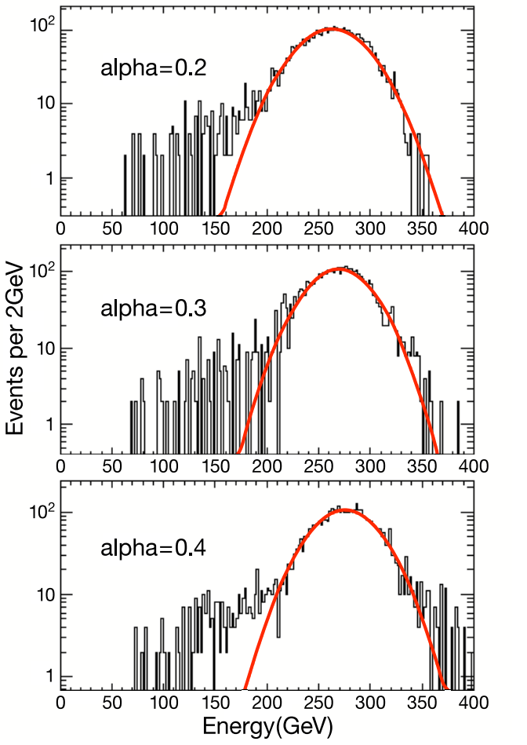
The best energy resolution was obtained with a Layer-0 weight of α = 0.3.
At α = 0.4, a tail at large energy, starts becoming evident.
The α = 0.2 spectrum has a larger rms than that for α = 0.3.
Figure 8: Single Gaussian fit to the signal distribution for 300 GeV/c pion beam
Source: CMS NOTE 2006/138

Slide 34
4.4 Noise Performance
The front-end electronics was operated at 33.79 MHz for all measurements reported in this paper.
The least count corresponds to 2080 electrons. The observed noise spread in the pedestal is less than 5000 electrons.
As will be seen from the beam measurements, this corresponds to an energy of ∼ 0.5 GeV

Slide 35
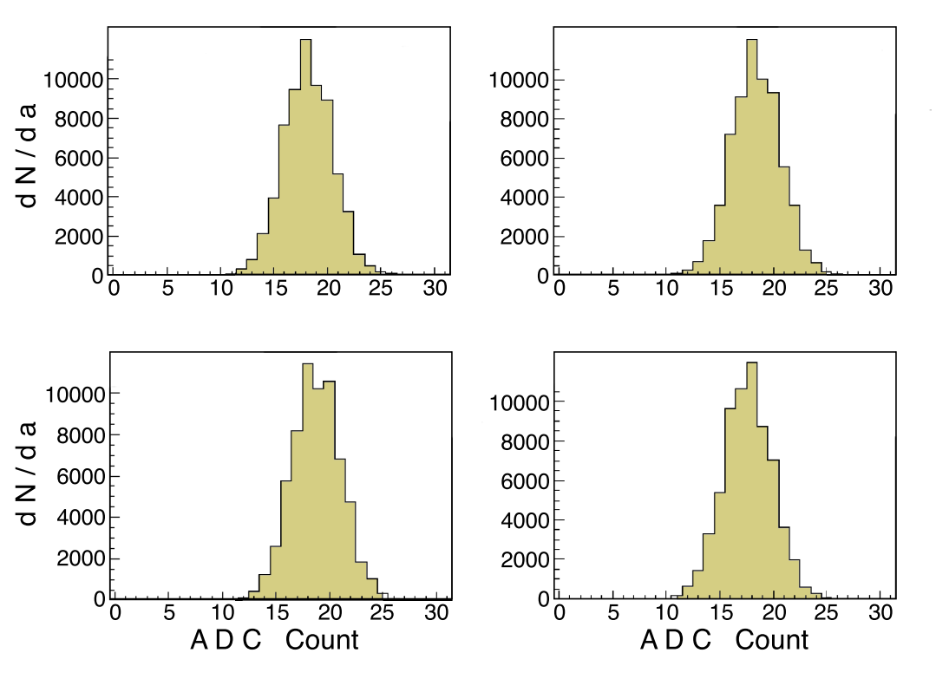
4.4 Noise Performance
The noise distribution at the highest gain setting of the multi-range ADC, for a single QIE channel.
Figure 9:
Measured pedestal distributions (dN/da) in units of raw ADC counts in the most sensitive
QIE range for 4 capacitor banks of the QIE. The rms is 2.3 ADC counts, independent of which capacitor bank stores the charge.
Source: CMS NOTE 2006/138

Slide 36
4.5 Time Structure
The time structure of the HB pulse is dominated by the scintillator decay times.
Two different measurements of the time structure of the pulse of deposited energy were made.
First, with a photomultiplier and commercial electronics; and second, with HPD and QIE electronics.

Slide 37
4.5.1 Measurements with a Photomultiplier Tube
A single 10-stage, 2-inch photo-multiplier tube (RCA 6342A) was used and the output was fed into a digital oscilloscope which recorded voltage in 0.4 ns bins.
Recorded 300 GeV/c and 20 GeV/c pion and 100 GeV/c electron showers, as well as signals from high energy muons.
In the case of muons, fluctuations in the number of photoelectrons lead to large event by event fluctuations.

Slide 38
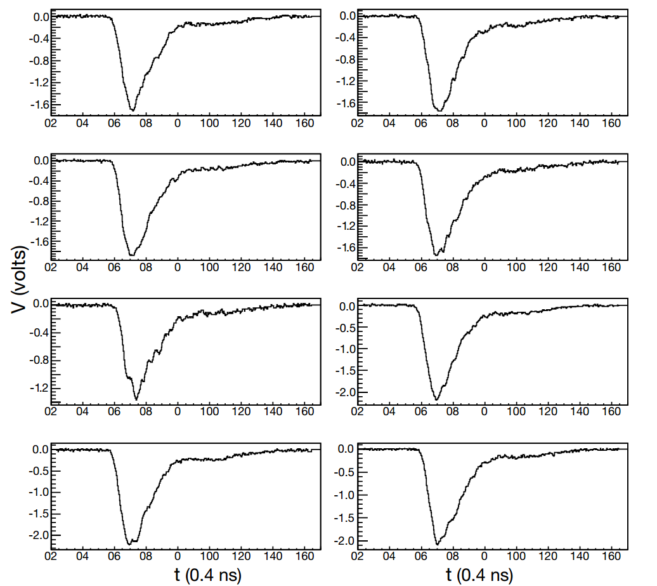
Figure 10: Calorimeter pulses for eight individual events, voltage vs time, observed with a photomultiplier
for 300 GeV pion showers. The time scale is 0.4 ns per bin.

Slide 39
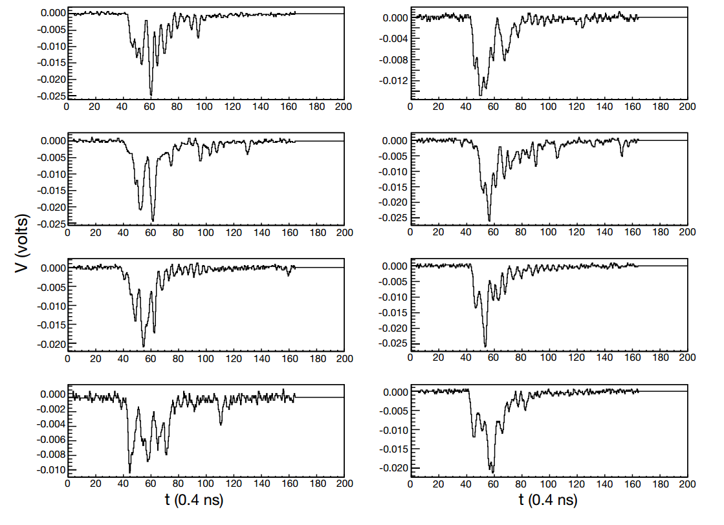
Figure 11:
Calorimeter pulses for eight individual events, voltage vs time, observed with a photomultiplier
for 225 GeV/c incident muons. The time scale is 0.4 ns per bin.
Source: CMS NOTE 2006/138

Slide 40
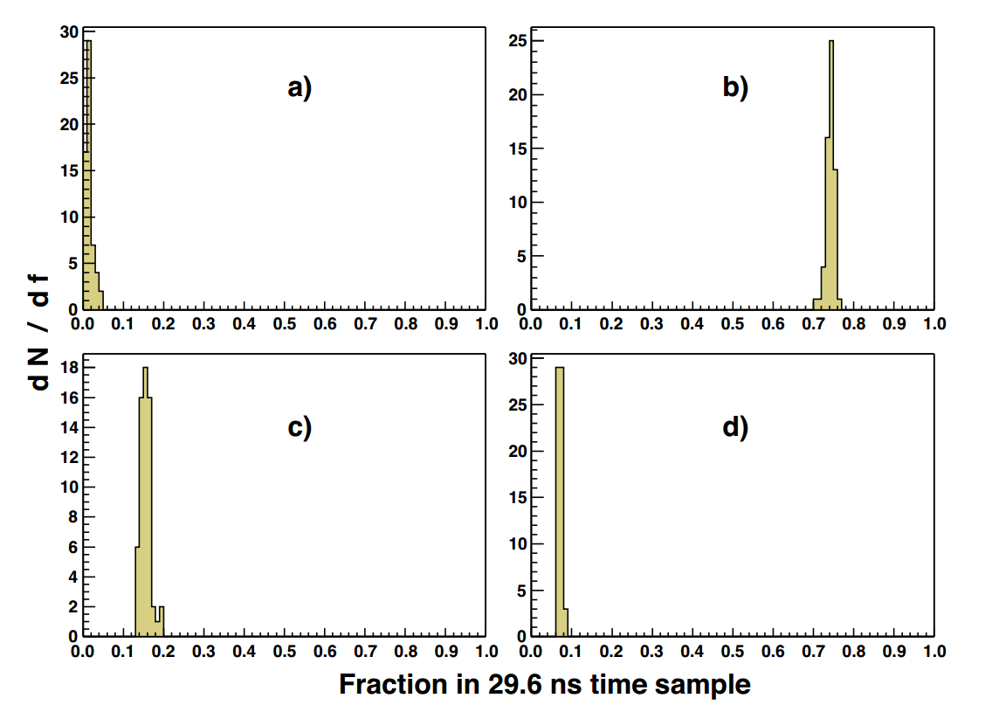
Figure 12:
Fraction of energy (f) observed in 29.6 ns time samples for 200 GeV/c pion showers.
a) first time sample,
b) second time sample, c) third time sample, and d) fourth time sample.
Source:
CMS NOTE 2006/138

Slide 41
4.5.2 HPD/QIE Measurements
Twenty time samples were recorded for each QIE channel.
The timing was adjusted so that the event occurred near the middle of the time sequence (sample number 10) to be able to record the noise performance well before and after the energy pulse.
At a frequency of 33.79 MHz, each time sample corresponds to 29.6 ns (slightly longer than the 25 ns between LHC bunch crossings).
Most of the signal is collected in two time samples.
Adjusted the phase of the random test beam particles by requiring that 10-12% of the observed energy is in the 10th time sample. Results show that all the events have the same temporal shape.

Slide 42
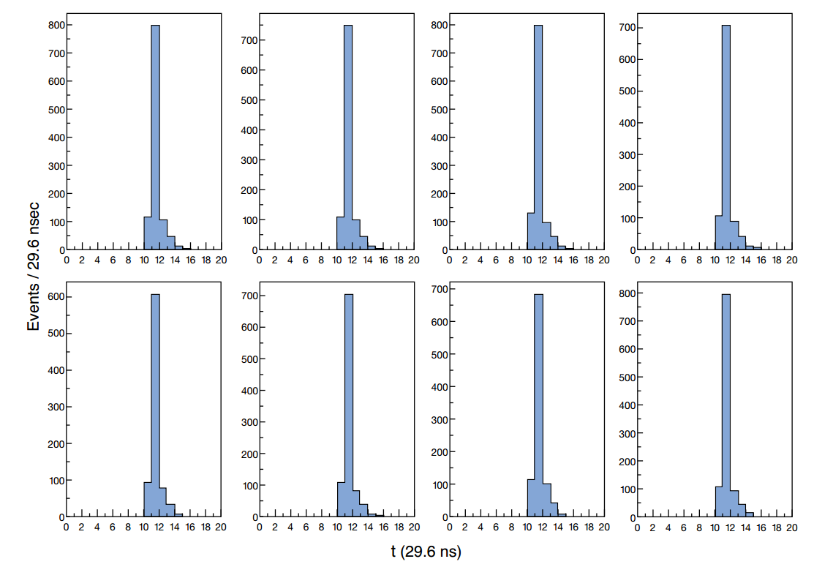
Figure 13:
Time structure for eight events with 300 GeV/c incident pions in which the phase is selected
by demanding that 10-12% of the observed energy is in time sample number 10.
Source: CMS NOTE 2006/138

Slide 43
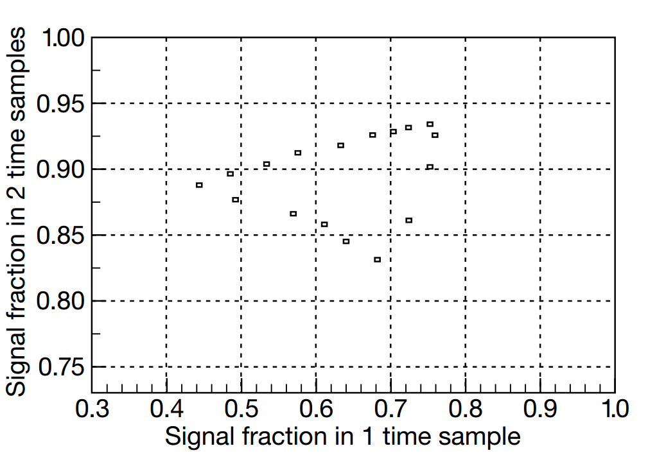
Figure 14:
Fraction of signal observed in two time sample vs that observed in a single time sample. The zero point is suppressed for each axis.
Source: CMS NOTE 2006/138

Slide 44
5. The HB Response to Pions and Muons

Slide 45
5. The HB response to Pions and Muons
With the 100 GeV/c pion beam centered on a tower, the fraction of energy observed in the single tower is on average 75%.
If the energy in the neighboring eight towers is added, forming a 3×3 array, 93% of the pion energy is observed.
The energy in a 5 × 5 array is 96%. The energy response for 100 GeV pions in a 5 × 5 array is shown in Figure 16.
A Gaussian fit suggests that the energy resolution at this energy is about 10%.

Slide 46
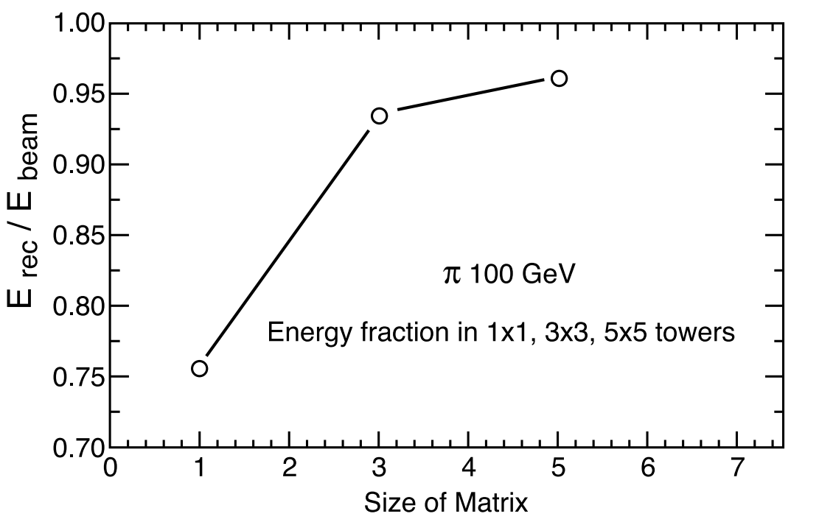
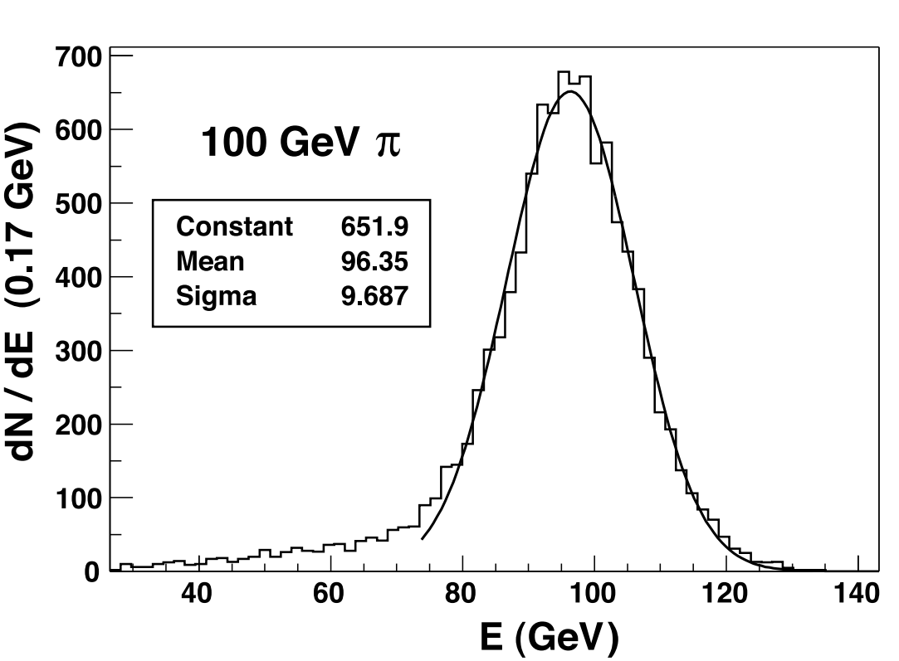
Figure 15:
Average transverse containment of a 100 GeV/c pion shower, in terms of the energy fraction observed in a single (1 × 1) tower, a (3 × 3) array of 9 towers and a (5 × 5) array of 25 towers. The beam is centered on the array
Source: CMS NOTE 2006/138
Figure 16:
The energy distribution in the HB (5 × 5 towers) for 100 GeV/c pions. The solid line is a single Gaussian fit to the histogram data with best fit values for the Gaussian parameters shown in the
figure legend.
Source: CMS NOTE 2006/138

Slide 47
5. The HB response to Pions and Muons
It is important to understand the response of the HB to muons not only for providing calibration redundant to the primary radioactive source method but also for particle identification purposes.
A feature bit will be reported for use in higher level triggers, when a muon is identified by the HB.
The signal, with 225GeV/c incident muons, is about 2.5 GeV on average and clearly visible above the electronic noise (∼ 0.5 GeV).
.

Slide 48
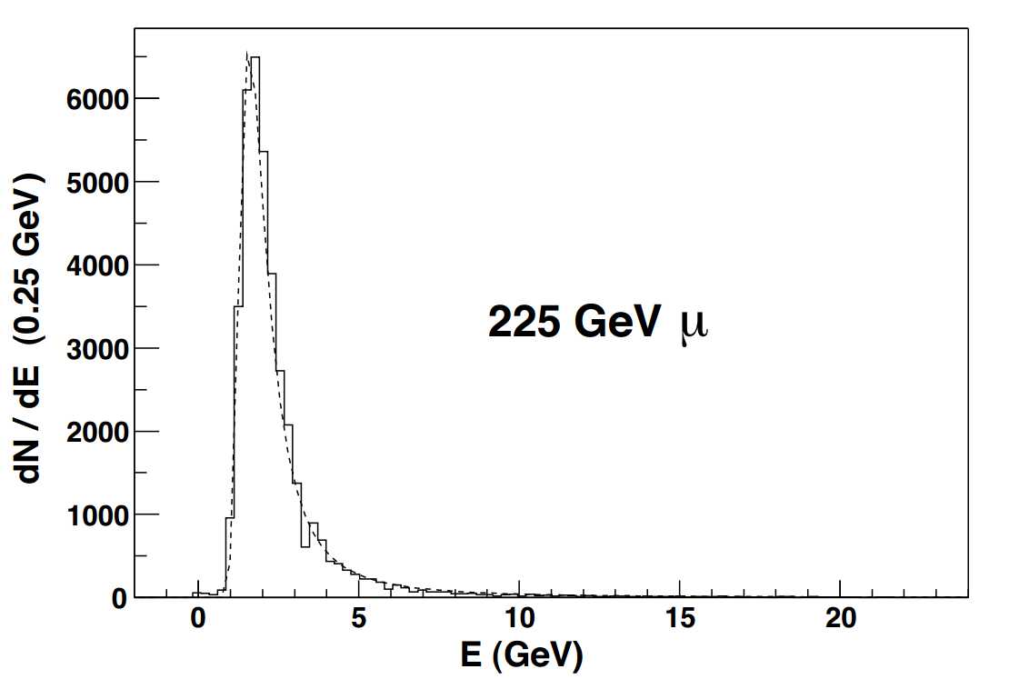
A Landau fit to this distribution results in 1.64 GeV for the most probable and 2.5 GeV for the mean value.
Figure 17: Observed energy distribution in the HB for 225 GeV/c incident muons. The most probable value for the energy deposited is 1.64 GeV while the mean is about 2.5 GeV. The dashed curve is the result of a fit to a Landau distribution.
Source: CMS NOTE 2006/138

Slide 49
6. The EB Response to Electrons
All 49 electromagnetic calorimeter crystals were calibrated with 100 GeV/c electrons.
The linearity of response of the EB module was studied at electron beam energies of 20, 30, 50 and 100 GeV/c.

Slide 50
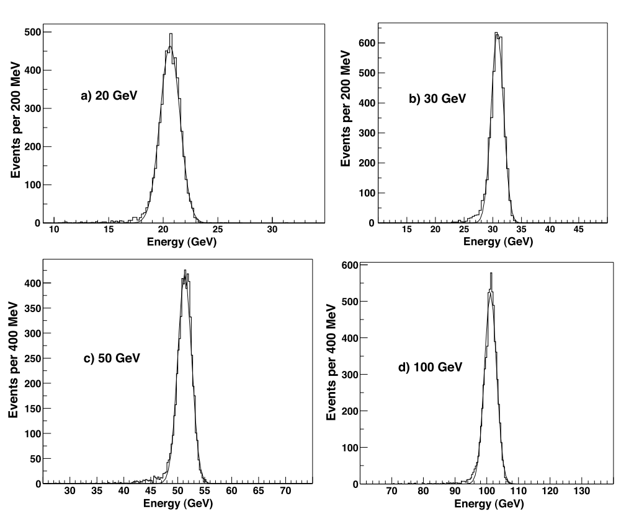
Figure 18: The single crystal EB response to incident electrons of energy a) 20, b) 30, c) 50, and d) 100 GeV/c for 5×5 crystal array.
The smooth curves represent single Gaussian fits to the histogram data.
Source: CMS NOTE 2006/138

Slide 51
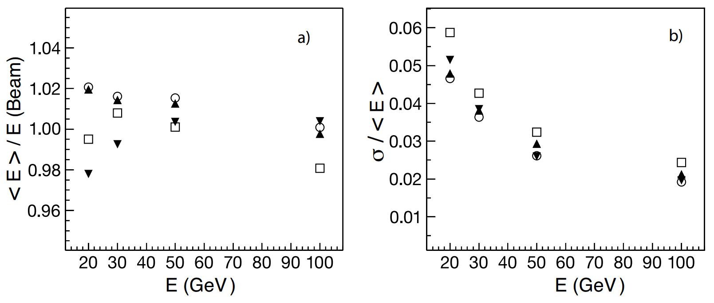
Figure 19:
a) Mean energy divided by the beam energy vs the beam energy.
b) The fitted Gaussian energy resolution vs the beam energy.
Source: CMS NOTE 2006/138

Slide 52
7. Performance of the combimed calorimeters: EB+HB

Slide 53
7.1 Energy Resolution and Response
The performance characteristics of the HB and the EB module were studied with pion beams of varying momenta. These pion beams were contaminated with muons and electrons.
The absolute energy scale of the HB was defined using a beam of 50 GeV/c pions directed at the combined calorimeter systems.
Only those pions which deposited less than 2 GeV in the EB were selected for the HB calibration.
The calibration factor was extracted as the ratio between the pion beam momentum and the mean of the distribution of summed HB energy deposited in a 5 × 5 tower array centered on the beam position

Slide 54
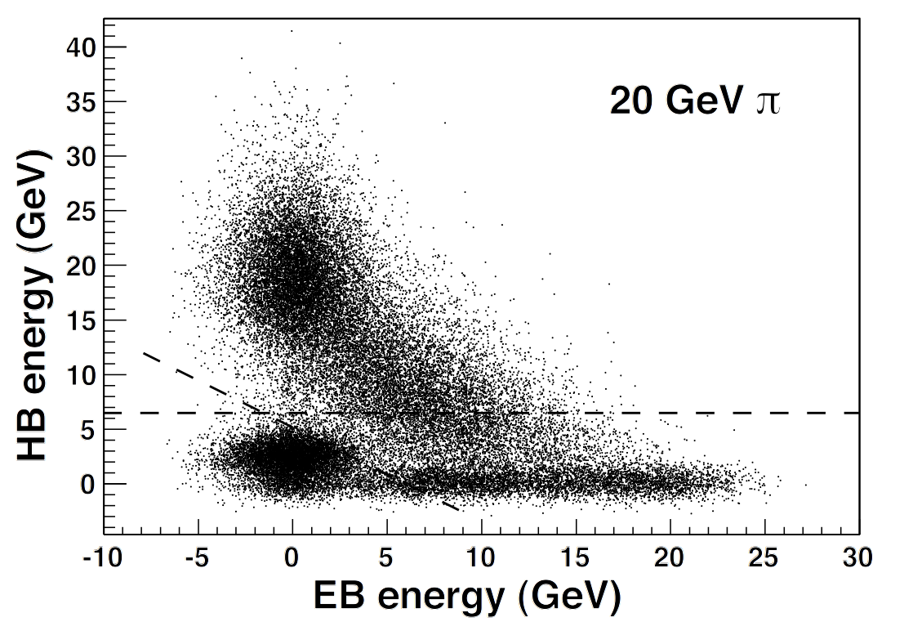
Figure 20:
Energy observed in the HB vs the EB module for 20 GeV/c pions. The dashed lines show the cut limits which were imposed to remove muon and electron contamination in the beam.
Source: CMS NOTE 2006/138

Slide 55
A series of cuts were developed to select pions in contaminated beams.
A cut EHB > 6.5 GeV, where EHB is the HB energy, was applied in order to eliminate the events with abnormally small HB energy and also to remove electron contamination.
An additional cut of EHB > −0.83E_{EB} + 5.2 GeV, where E_{EB} is the energy measured by the EB, was made to reduce the mu on background.
These energy response and energy resolution measurements were corrected for the effect of the beam cuts, using a Monte Carlo simulation based on GEANT4.

Slide 56
Beams of pions were generated and showered in the EB and the HB, and the resulting distributions were scaled up to match the measured mean energy.
The quality cuts for background rejection were then applied and the correction factors were derived.
The correction factors to the energy response and the resolution for 20 GeV/c (30 GeV/c) pions are 0.931 (0.987) and 1.056 (1.018), respectively. The corrections factors at higher energies are negligible.

Slide 57
There are three contributions to the quoted HB calibration error.
One comes from the 2 GeV cut to the EB energy deposition by 50 GeV/c pions, The second contribution comes from the background subtraction method applied to the 50 GeV/c calibration sample.
The third component comes from the statistical error on the mean of the 50 GeV/c distribution.
Added in quadrature, the total calibration uncertainty is ±1.3%.
This error on the pion energy was propagated to the mean and width of the distributions by recalculating the total energy with the nominal, high, and low calibration factors.

Slide 58
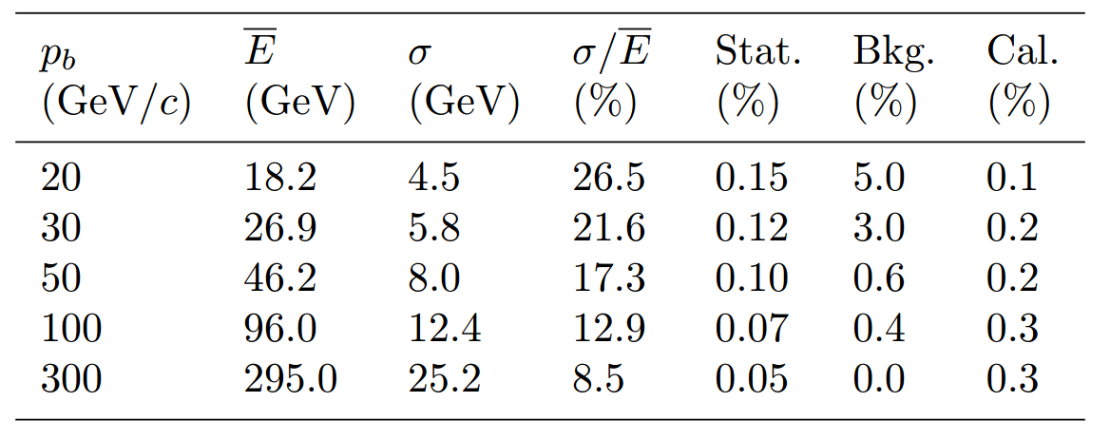
Table 2: The energy resolutions and the associated errors ascribed to statistics, background and the
calibration uncertainties for pions at five different beam momenta.
Source: CMS NOTE 2006/138
The fits are applied to the raw data and no correction is made for the large e/h value of the electromagnetic calorimeter. Results are in agreement with GEANT4 within the systematic errors and the available beam momentum range.

Slide 59
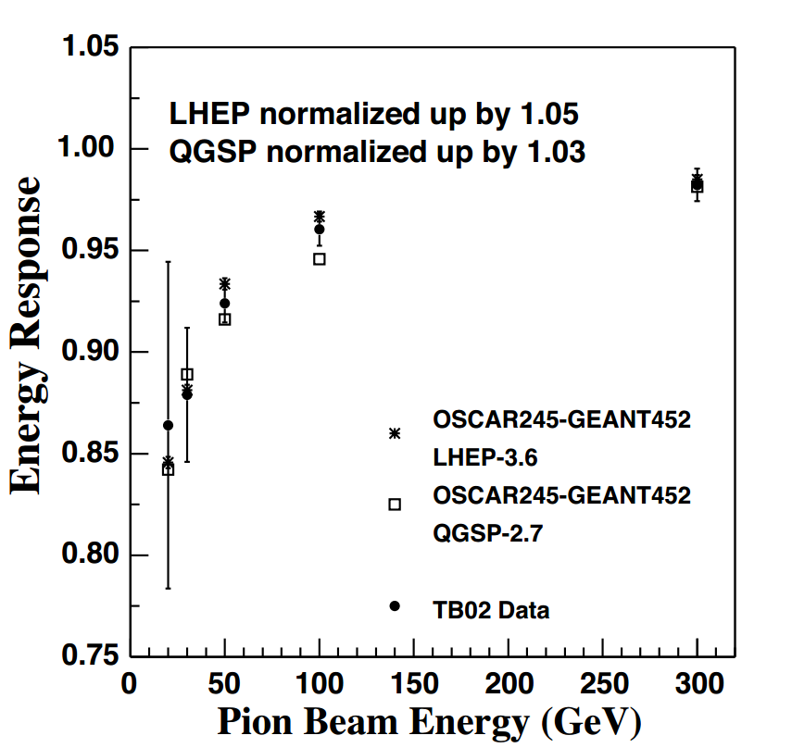
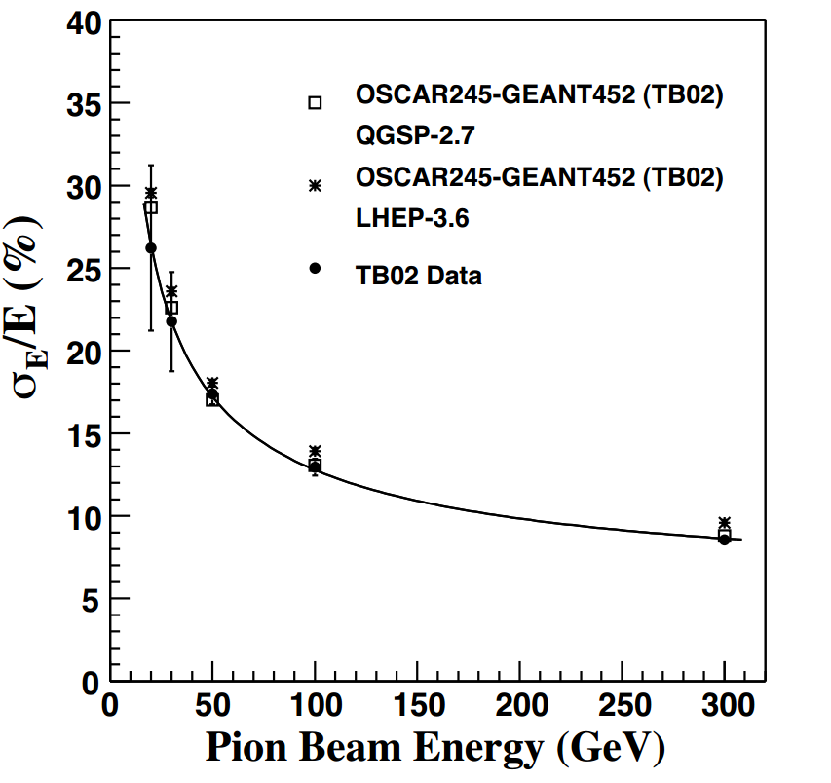
Figure 21: The measured energy resolution(solid circles) with fit (solid line) (σ/E) = 115 √.E 3% ⊕ 5.5% compared to two different tunes of GEANT4 (open squares and stars). The symbol ⊕ implies that two terms are added in quadrature.
Figure 22: The measured energy response (solid circles) linearity compared to the GEANT4 simulations with different physics lists. The error bars indicate the statistical and systematic uncertainties added in quadrature.
Source: CMS NOTE 2006/138

Slide 60
8. Comparison with GEANT4

Slide 61
The CMS Collaboration developed the Object oriented Simulation for CMS Analysis and Reconstruction (OSCAR) framework, based on the GEANT4 tool kit, to describe the detector geometry and the passage of particles through the detector material.
GEANT4 uses either parametric (LHEP) or microscopic (QGSP) physics models to simulate the particle showers arising from the interaction of particles with matter.
For the studies presented in this paper, the software package OSCAR 2.4.5 is used, based on GEANT 4.5.2, with LHEP 3.6 and QGSP 2.7 physics lists or models.

Slide 62
A detailed comparison using GEANT4 was made for one tower location. The electronic noise was taken to be 520 MeV. The secondary particle cuts were set to 1 mm for both electrons and positrons, and 10 mm for photons, except in the electromagnetic calorimeter where the photon cut was set to 1 mm.
The energy calibration of the EB and HB followed closely the same procedure used in the beam measurements.
For 100 GeV/c electrons in the electromagnetic calorimeter, the two GEANT4 physics lists, LHEP-3.6 and QGSP-2.7, give energy resolutions in excellent agreement with each other.
For the EB, an additional scaling term was introduced so that the electron energy resolution simulated in the range 20-100 GeV/c agreed with the experimental values.

Slide 63
The relative degradation in the energy resolution for pions when incorporating the extra smearing into the energy observed by the EB is 3% (1% absolute) at 20 GeV/c, and 0.6% (0.06% absolute) at 300 GeV/c.
The measurements are in good agreement with the simulation for the two physics lists tested.
The LHEP-3.6 gives an energy resolution a few percent larger than the QGSP-2.7.
The experimental data and the Monte Carlo predictions are more straightforward to compare in ratio:

Slide 64
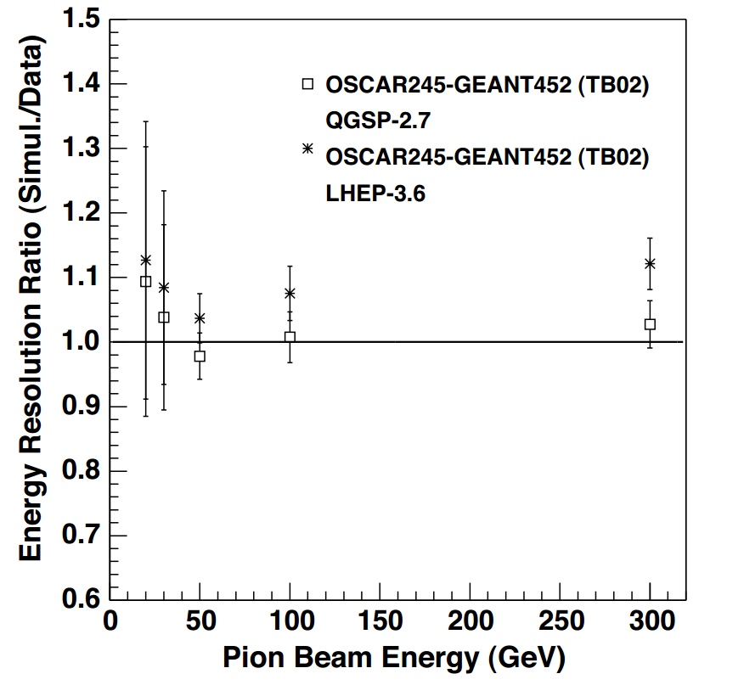
The importance of the electronic noise contribution increases as the pion beam energy decreases.
At 20 GeV/c, the resolution degrades by more 15 than 30% when a realistic electronic noise model is incorporated into the simulation.
LHEP-3.6 predicts a slightly faster growing response with energy compared to that measured, the one derived from the QGSP-2.7 increases more slowly.
The electronic noise does not affect this measurement significantly.
Figure 23: The energy resolution ratio of the different tunes of GEANT4 (open squares and asterisks) to the test beam data as a function of the pion beam energy. The solid line represents perfect energy independent agreement.

Slide 65
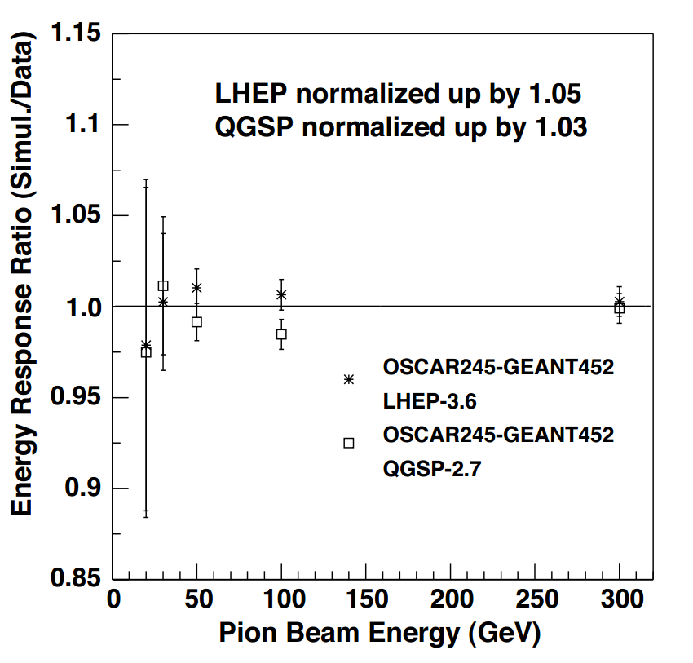
Figure 24: The energy linearity ratio of the different tunes of GEANT4 (open squares and asterisks) to
the test beam data as a function of the pion beam energy. The solid line represents perfect energy
independent agreement.
Source: CMS NOTE 2006/138

Slide 66
9. Radioactive Source Calibration

Slide 67
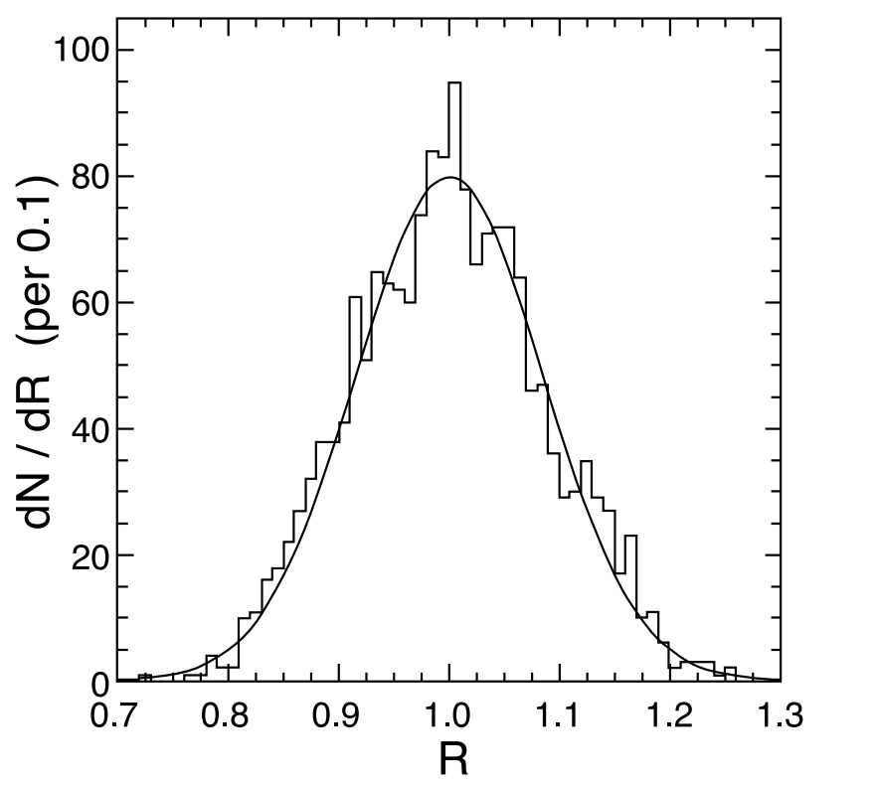
The radioactive source calibration is performed for every scintillator tile.
The ratio of the radioactive source signal to the energy response to the pions in the beam for each tower provides the initial calibration.
This ratio depends on the type and activity of the source.
The signals from 1745 tiles, corrected for the different fiber attenuation, are shown in figure.
The width of the distribution is 8% and it is consistent with the measurements of tile uniformity made during tray reconstruction.
Figure 25: Distribution of scintillating tile response (R) to the source calibration normalized to the mean of the distribution. The line represents a single Gaussian fit to the data.

Slide 68
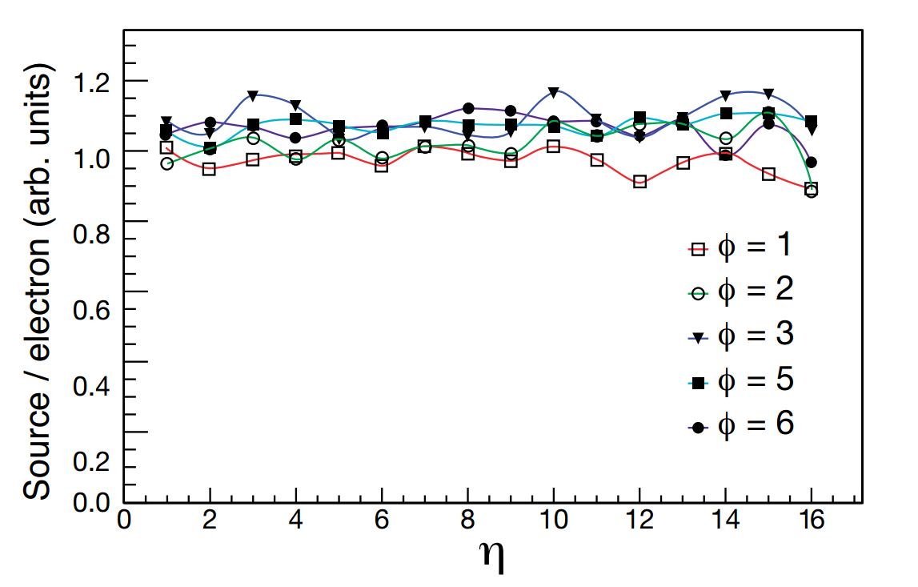
Dependence of the ratio of radioactive signal to the electron signal on the tower number.
Figure 26: Ratio of the radioactive source signal (fit to peak value) to the 100 GeV/c incident electron
signal in the HB vs η number of the tower for five different φ numbers (80 towers total).

Slide 69
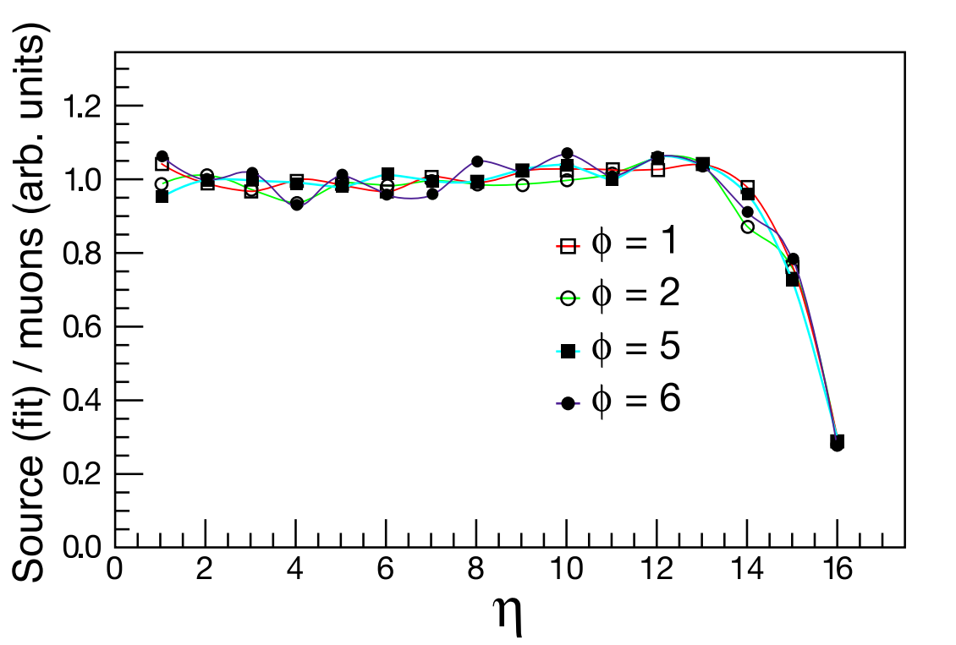
Dependence of the ratio of radioactive signal to the muon signal on the tower number.
Figure 27: Ratio of the radioactive source signal to the HB signal due to a 225 GeV/c beam of incident muons vs η number for four different φ numbers (64 towers total). Towers with the number 15 and 16 have longitudinal segmentation which is not corrected for in this plot

Slide 70
The electron response agrees with the radioactive source measurements to an rmsof 5%, while the muon data agrees to 3%.
The greater spread in the electron data is attributed to the fact that the electron shower is concentrated in the first few scintillator layers, while the source measurement is averaged over all layers with equal weight as is the muon signal.
The muon data are therefore better suited to establish the HB tower-to-tower relative calibration. The electron data, however, establish the absolute energy scale. Therefore, we have a cross check of the calibration initially established by pions.

Slide 71
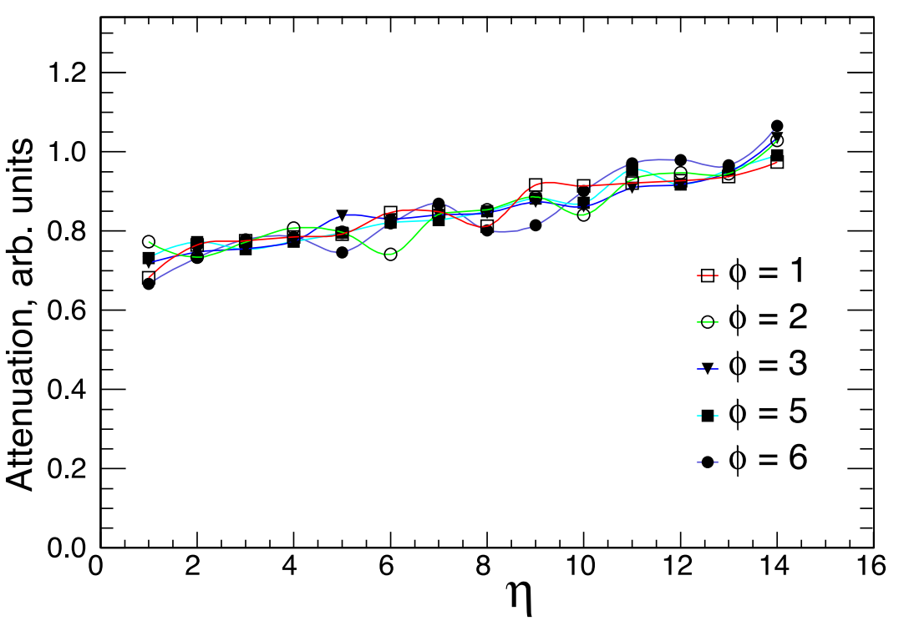
The length of the optical fibers between the scintillators and the HPDs varies with η. Figure shows the relative response to the radioactive source as a function of η. These data show that the light level at the HPD is about 30% lower for η = 1 towers when compared to η = 14 towers. The η = 15 and 16
Figure 28: Measurement of the attenuation vs η number for five different φ numbers (80 towers total)..

Slide 72
Summary

